Slide 1
Android Games Analysis – Why Does my playtime reduce my talk time?
Team – Hunger-Games

Slide 2


Motivation
Games = 16% of the total time spent on mobile apps in US. _{COMSCORE}
Appeals to diverse group of audience
Advent of modern technology and higher configuration => innovative games

Slide 3
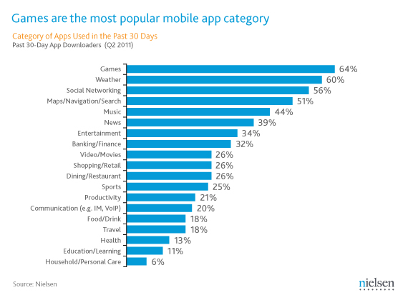
Most popular mobile app category

Slide 4
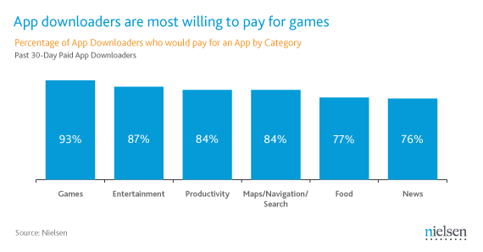
Will you pay to purchase mobile games?

Slide 5
However…???!!
Put Verizon link and info here

Slide 6
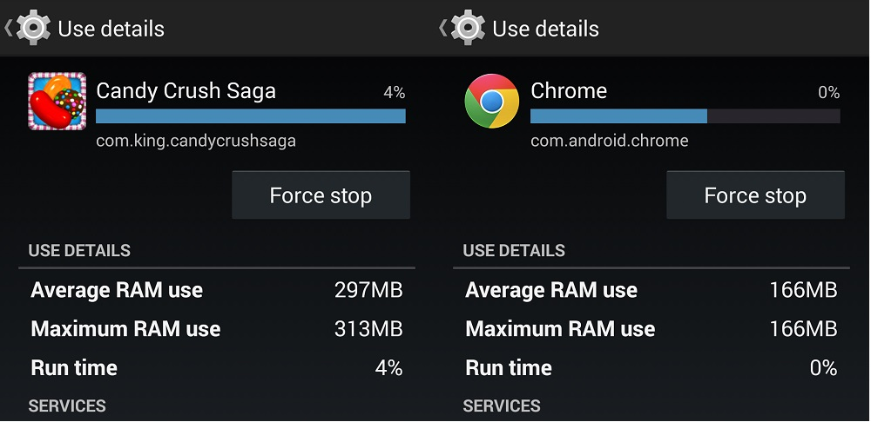
Bad User Experience
High Memory (RAM) usage

Slide 7
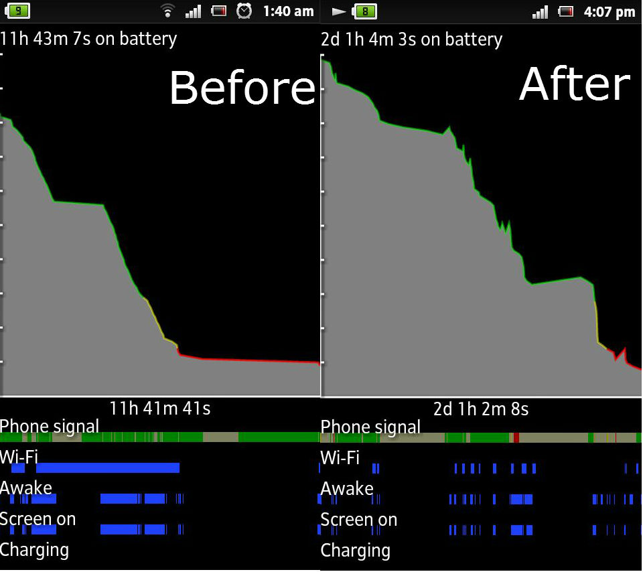

Bad User Experience
High Battery consumption
[Change this image
before after]

Slide 8
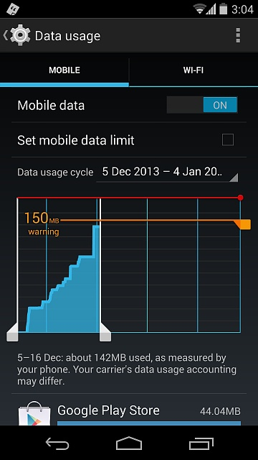

Bad User Experience
Unexpected High data usage

Slide 9
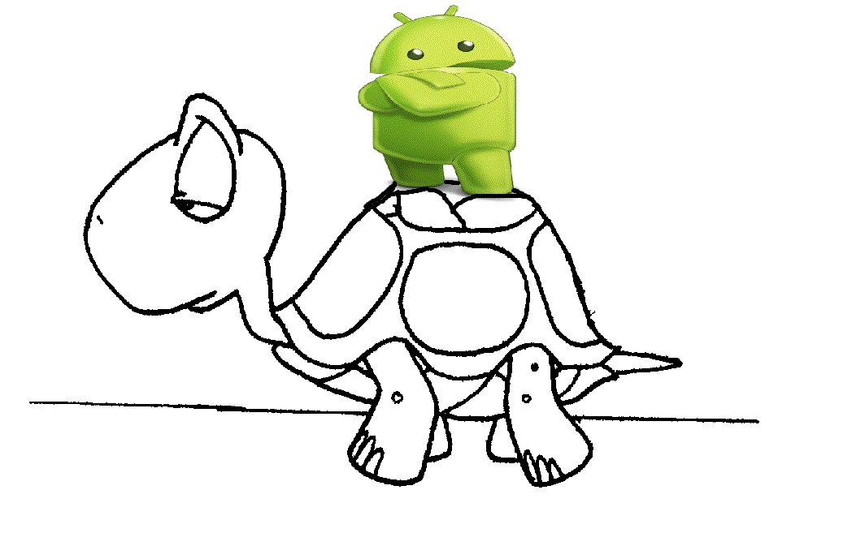

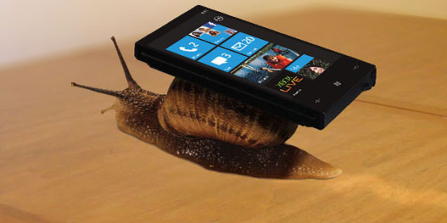
Bad User Experience
Performance Slowdown

Slide 10
Project Idea
What can be done?
Trying to find inefficiencies in online mobile games in terms of memory usage, data usage and performance.
Approach
Data Collection
Analysis
Recommendation

Slide 11
Challenges
Time Constraint
Data collection and user availability
Data Isolation
High bandwidth data usage collection

Slide 12


End goal
Industry perspective
Better games and
efficient resource consumption
Increase in games usage and revenues
End-user perspective
Controlled data usage
Better performance
Better battery life

Slide 13
Timeline
Feb 13, 2015 – Feb 20, 2015: Design
Identifying test subjects.
Initial Design, Tools and installations.
Games finalization
Hardware acquisition (SIM and phones if required)
Feb 21, 2015 – Mar 20, 2015: Implementation
Data Collection Phase
Mar 21, 2015 – Apr 10, 2015: Evaluation
Data Analysis and Recommendation
Apr 11, 2015 – Apr 30, 2015: Project Report

